Slide 1






sql project
on pizza
sales

Slide 2



In this project, we utilized SQL queries to address various problems related to pizza sales. Our goal was to analyze sales data, identify trends, and gain insights into customer preferences and operational efficiency. By executing targeted SQL queries, we were able to extract, filter, and aggregate data to understand popular pizza types and toppings, identify peak sales periods, compare sales across locations, and recognize customer purchase patterns. This analysis provided valuable information to optimize inventory management, improve marketing strategies, and enhance overall business performance.

Slide 3
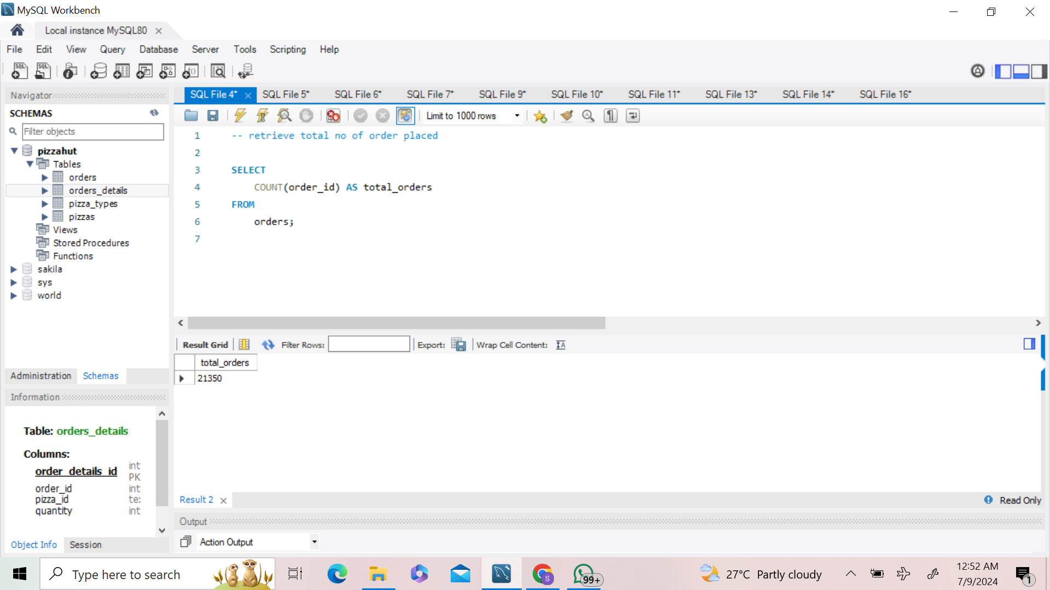

q1 - retrieve total no of order placed

Slide 4
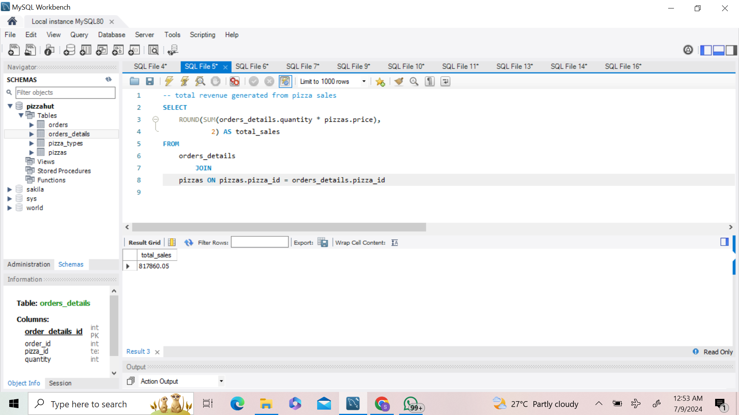
q2 - total revenue generated from pizza sales

Slide 5
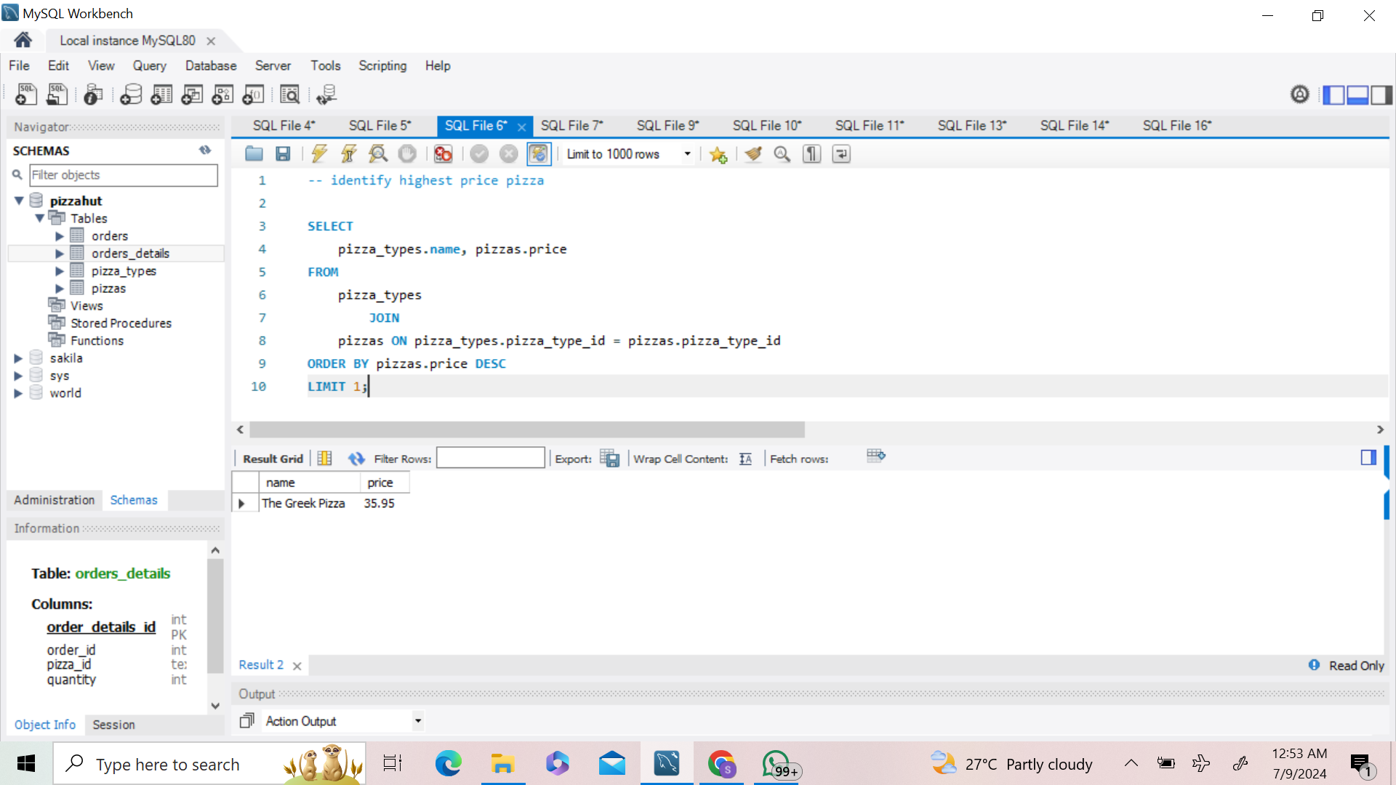
q3 - identify highest price pizza

Slide 6
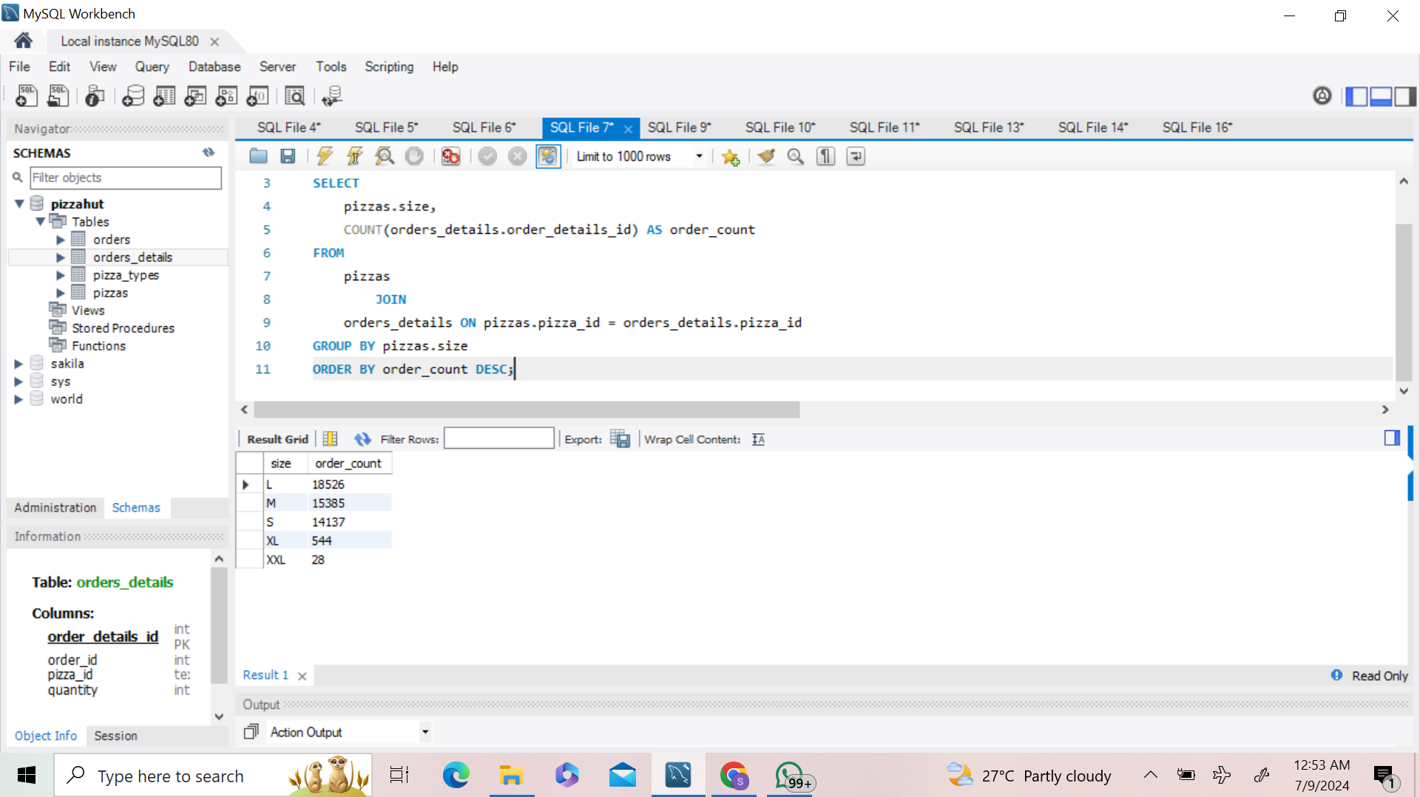
q4 - identify most commom pizza size

Slide 7
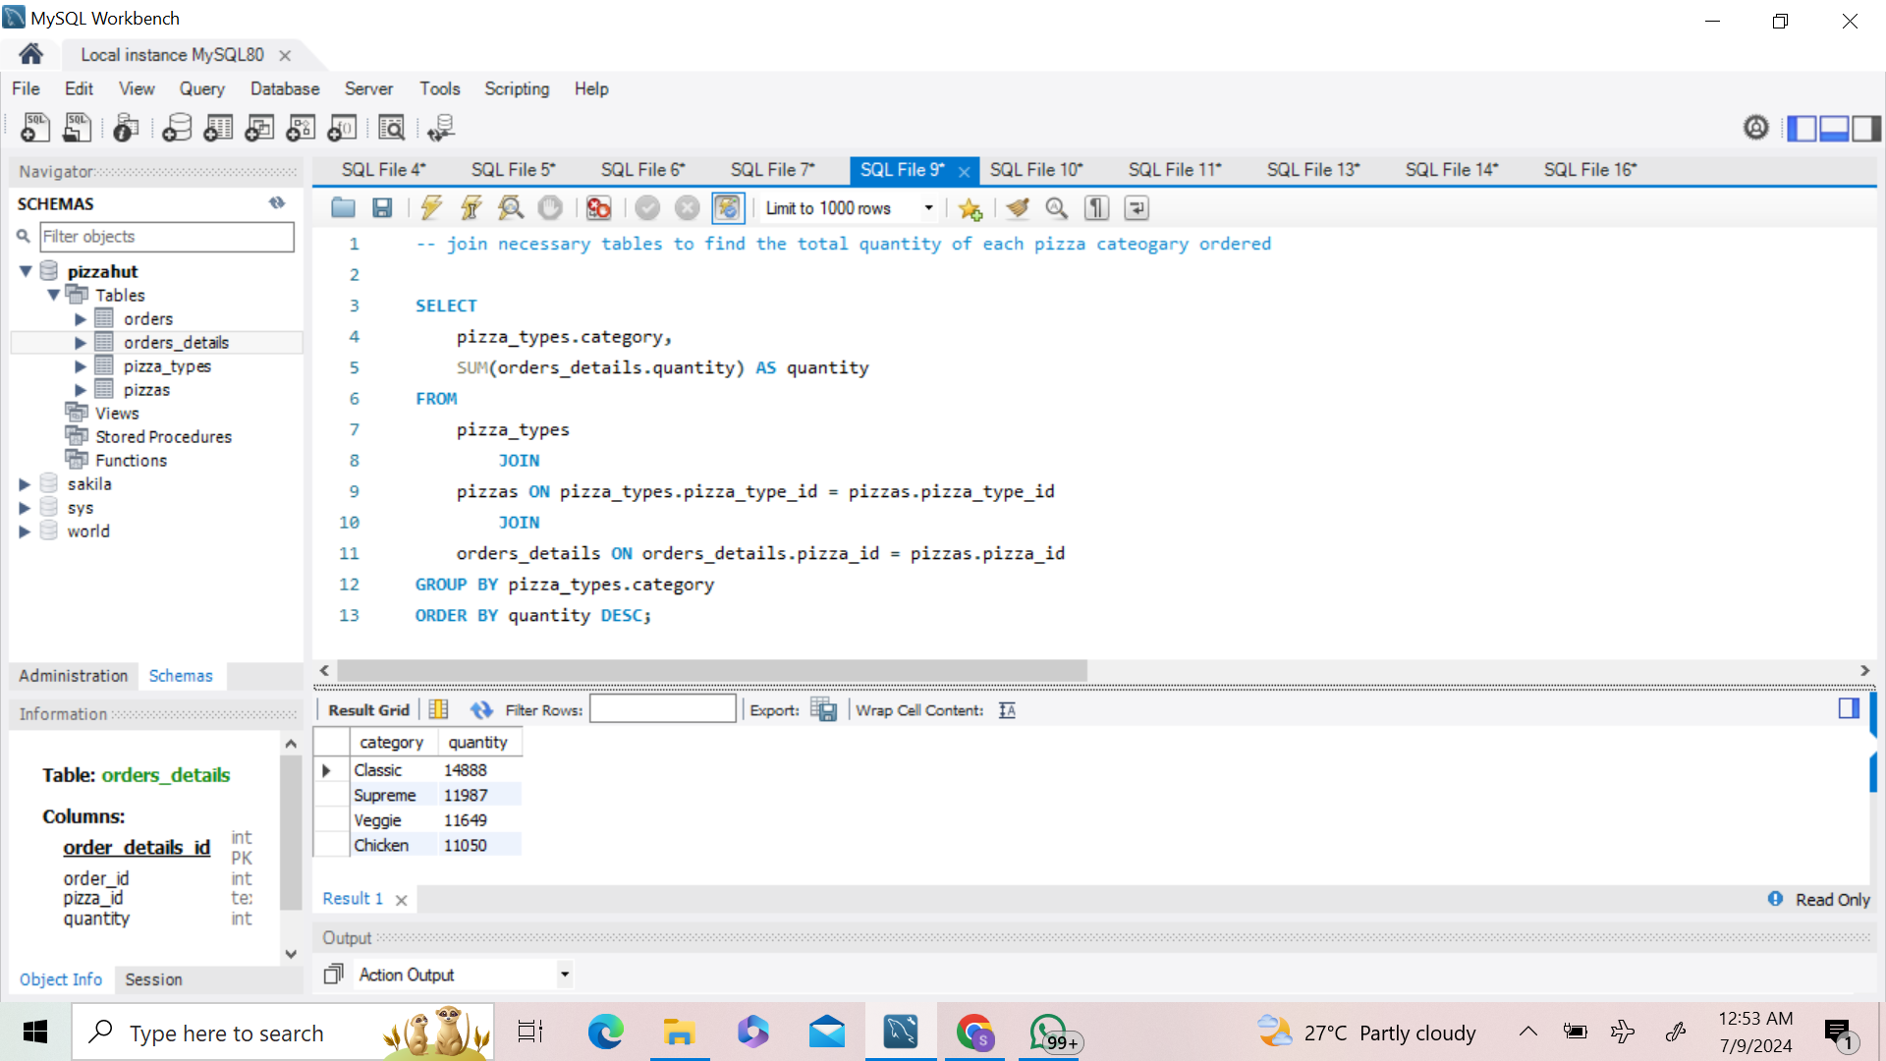
q-5 join necessary tables to find the total quantity of each pizza cateogary ordered

Slide 8
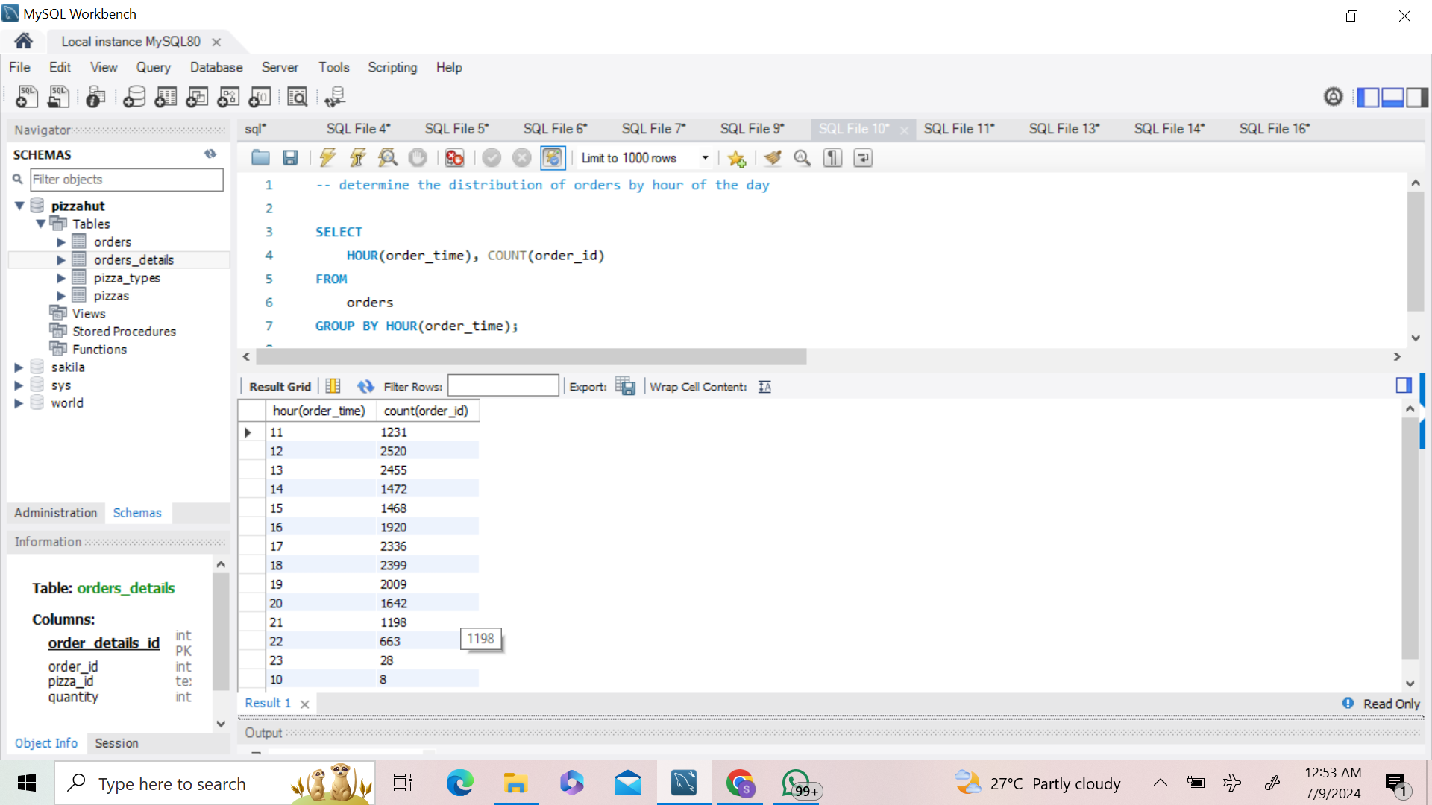
q6 - determine the distribution of orders by hour of the day

Slide 9
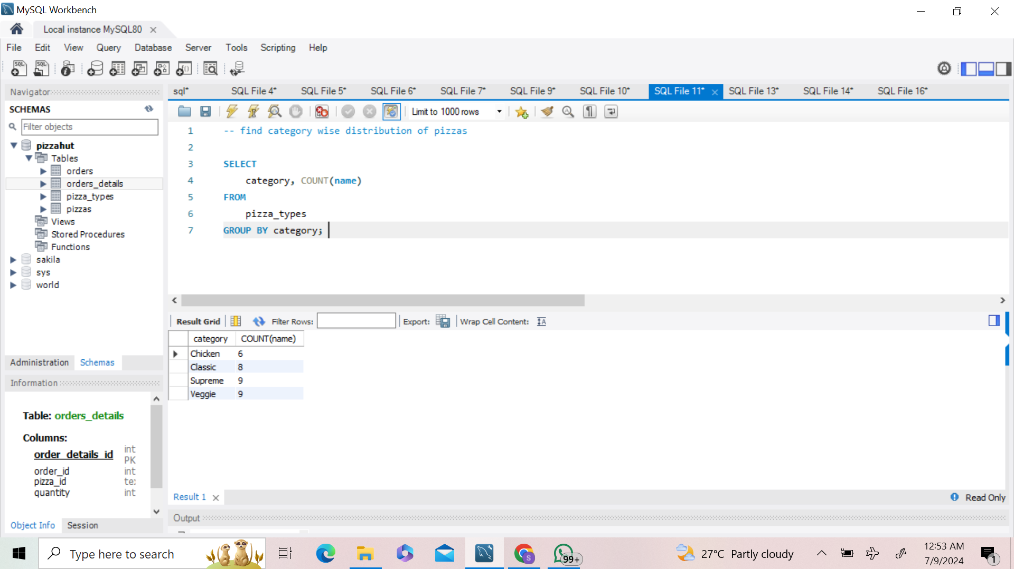
q7 - find category wise distribution of pizzas

Slide 10
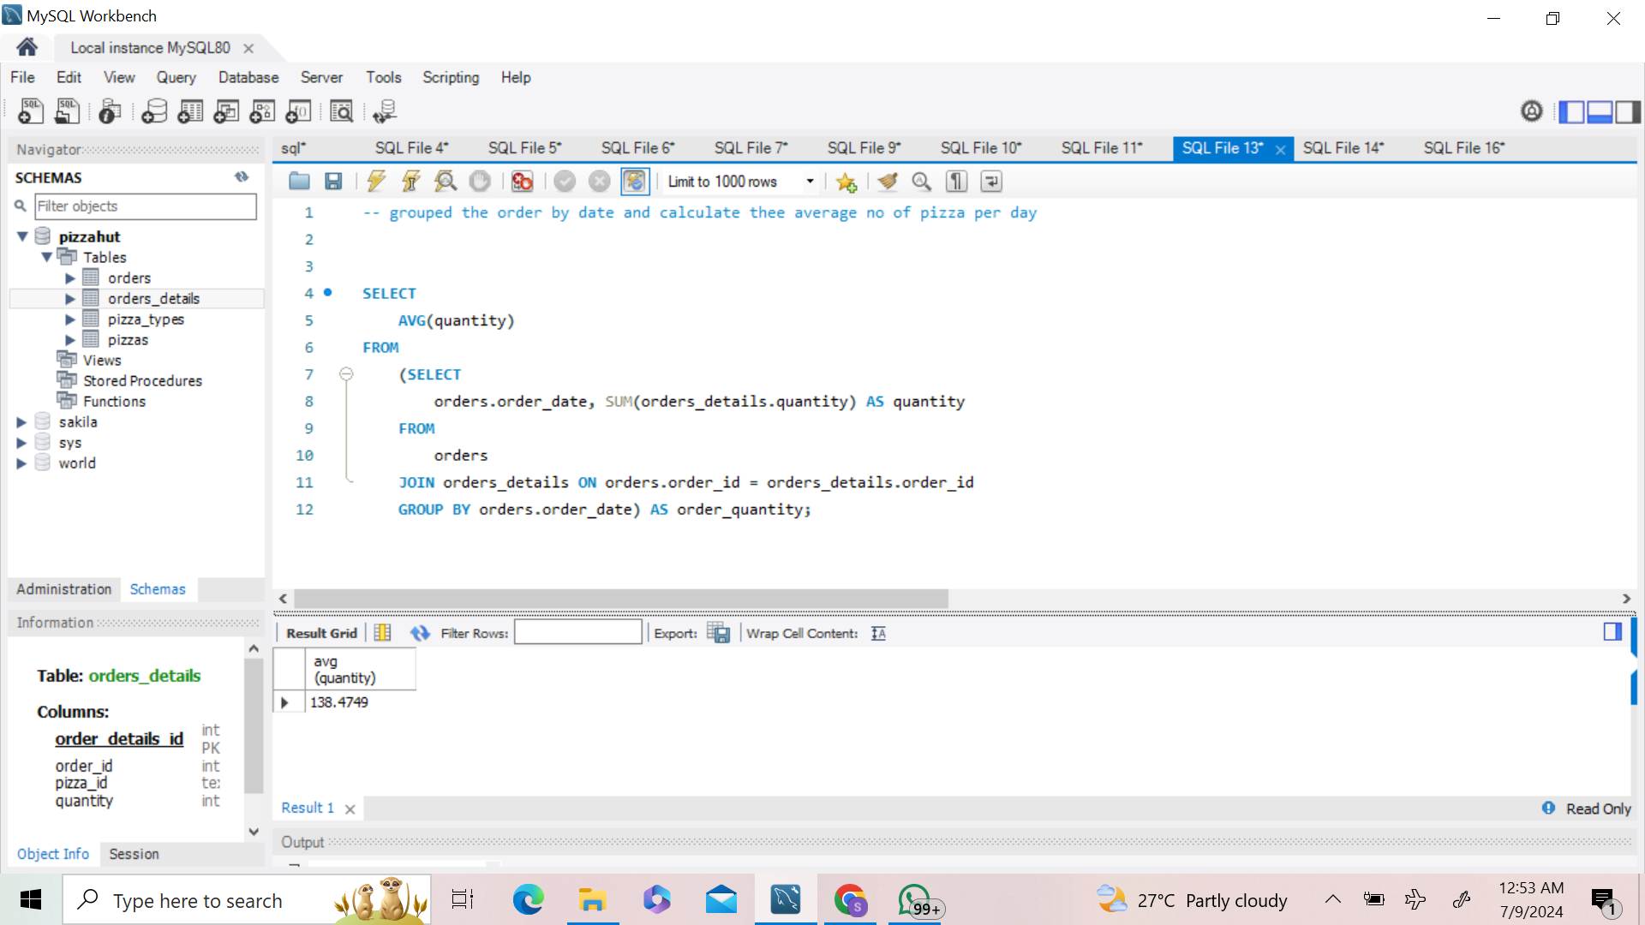
q8 grouped the order by date and calculate thee average no of pizza per day

Slide 11
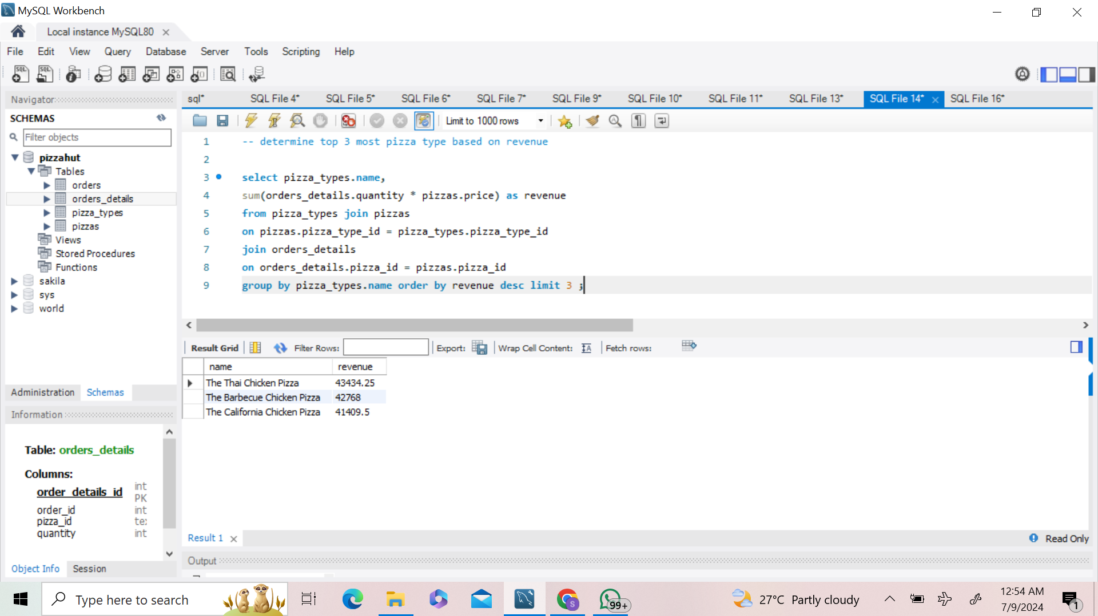
q9 determine top 3 most pizza type based on revenue

Slide 12
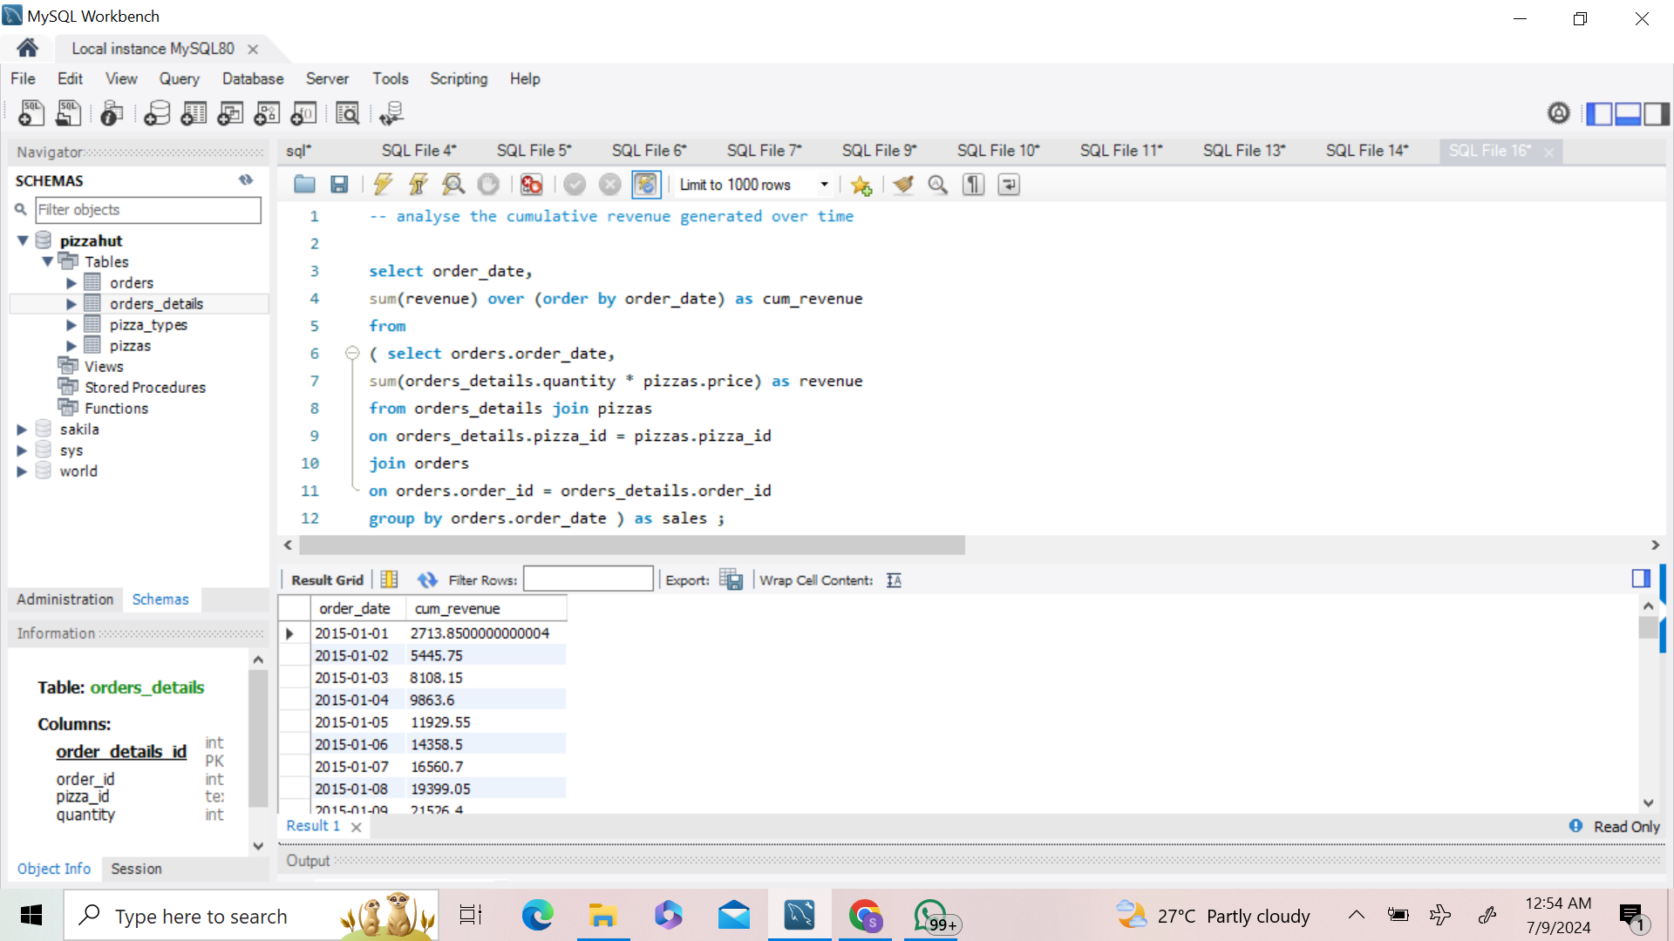
q10 analyse the cumulative revenue generated over time

